Slide 1
Originating Auto Loans on Blockchain
On the Road Lending
1500 N. Loop 12, Irving, TX 75061
Ontheroadlending.org
Dave Eddy
David_s_eddy@Hotmail.com
Michelle Corson
mcorson@ontheroadcompanies.com

Slide 2
Originating Car Loans on Blockchain On the Road Lending
Company Overview:
Part of a family of companies with a mission to build prosperity for America’s working families through financial and transportation innovation
Related entities include On the Road Sustainability Funds (which actually makes the loans), On the Road Motors (a Texas motor vehicle dealer), On the Road Garage (a collision repair and training facility in advanced auto technology), and Champion Impact Capital (an impact investment advisory company).

Slide 3
Auto Finance Value Chain
Customer Acquisition
Underwriting
Origination
Servicing
Compliance
Advertising
Partner Agencies
Loan Aggregators
Client Referrals
Risk analysis
Financial capability
Verification
Loan documents
Loan vaulting
Loan setup
Receive Payments
Amortize
Investor Waterfall
Licensing
Partner Impact Reporting
Servicing Reports
Supporting Systems
Salesforce CRM (not designed for loan origination)
Credit Bureaus
AutoPal, Docusign
Auto Pal
QuickBooks

Slide 4
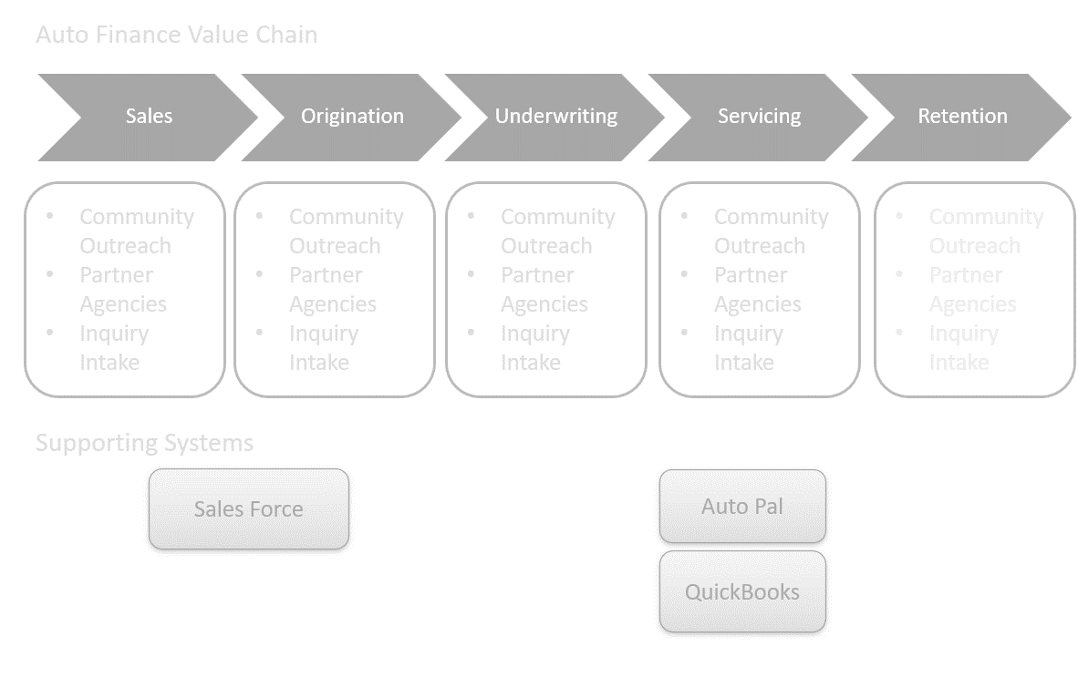
Pain Points
Inadequate functionality
Process Inefficiency
Siloed systems
Intermediary Costs

Slide 5
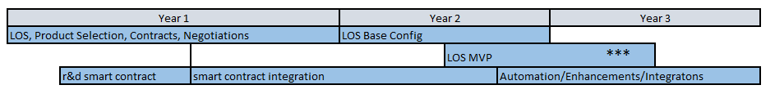
Road Map

Slide 6
Road Map
Full Blockchain Scope Considerations
Customers register and establish identity within blockchain via mobile app
Systems supports loan application process
Integration with Document Management Solutions
Save the loan application
Support digital signature
VIN/Asset Management
Vehicle Identity Stored on chain
Associated with Loan
Payment Processing (with crypto)
Crypto asset backing the loan
Smart contract linking the loan to the asset
Payments made into a wallet address associated with the smart contract

Slide 7
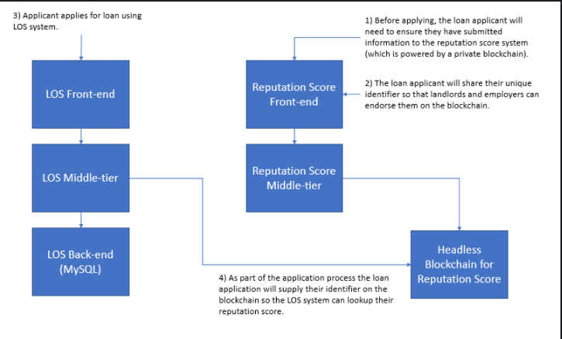
The focus of the UTD Capstone project will be building the Reputation Score components.

Slide 8
Project Title Company Name
Insert company logo here
Project Objectives:
Give brief project objectives here.

Slide 9
Project Title Company Name
Insert company logo here
Skill Sets
Required Skills
Demonstrated Interest in Blockchain Development. (No skills required at the start. The existing prototype of the private blockchain is written in Node.js)
Skills to be Developed The UI components will be in react.js and we will be deploying on AWS using docker image. Some experiences in these area will be helpful but not required.

Slide 10
Project Title Company Name
Logistics
List student restrictions (US citizenship, etc)
None
Provide mtg frequency (weekly, biweekly, etc)
We will follow scrum methodology and hold the appropriate ceremonies. Sprint cycle is 2 week.
Provide mtg location if known
online

